Slide 1
Topic 10
Session Tracking:
Cookies & PHP_Session

Slide 2
HyperText Transfer Protocol (HTTP)
HTTP is the de facto standard for transferring World Wide Web documents
  it was designed to be extensible to almost any document format
HTTP operates over TCP connections
  usually on port 80

Slide 3
HyperText Transfer Protocol (HTTP)
HTTP is stateless
  HTTP servers respond to each client request without relating that request to previous or subsequent requests
  i.e. The current web page does not remember what was done in the previous page.
After a successful connection, the client transmits a request message to the server, which sends a reply message back

Slide 4
Session Tracking:
Hidden Fields

Slide 5
Session Tracking: Hidden Fields
Hidden field is one of the HTML form component
    <input type=“hidden” name=“counter” value=“10”>
When passing session data from one page to another,
  Try: write PHP scripts to generate hidden fields to store some data from the previous page

Slide 6
Example: Session Tracking Hidden Fields 1
<html>
…
<form action=“process.php”>
Quantity <input type=“text” name=“qty”>
…
</html>

Slide 7
Example: Session Tracking Hidden Fields 2
process.php
  <html>
  …
  <form action=“total.php”…>
  <?php
  $myQty = $_REQUEST[‘qty’];
  echo “<input type=‘hidden’ name=‘qty’ value=‘$myQty’>
  ?>
  …
  </form>
  </html>

Slide 8
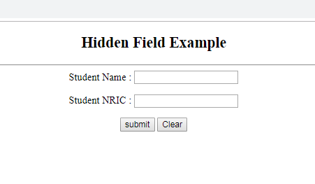
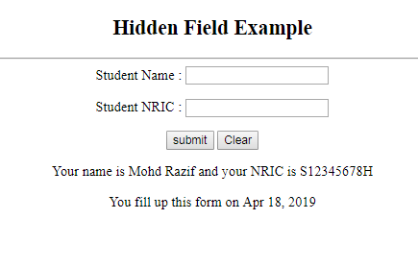
Example: Session Tracking Hidden Fields 3
Date value from hidden field

Slide 9
Example: Session Tracking Hidden Fields 3
<!DOCTYPE html>
<html>
<head> <title>Hidden Field Example</title></head>
<body><center><h2>Hidden Field Example</h2><hr />
<form action="" name="hiddenField" id="hiddenField" method="post">
Student Name : <input type="text" id="StudName" name="StudName" required><p />
Student NRIC : <input type="text" id="StudNRIC" name="StudNRIC" required><p />
<input type="hidden" id="date" name="date" value="<?php echo date('M d, Y'); ?>">
<input type="submit" name="submit" id="submit" value="submit">
<input type="reset" name="reset" id="reset" value="Clear">
</form>
</center></body>
</html>
<?php
if (isset($_POST['submit'])) {
$StudName = $_POST['StudName'];
$StudNRIC = $_POST['StudNRIC'];
$date = $_POST['date'];
echo "<p><center>";
echo "Your name is $StudName and your NRIC is $StudNRIC <p />";
echo "You fill up this form on $date";
echo "<p></center>";
}
?>

Slide 10
Session Tracking:
Cookie Time…
Let’s bake some cookies

Slide 11
Cookies
Cookies are like memory variables that stores data
Cookies, if not expired,
  are simple text files that are stored persistently on the client side.
Cookies can be stored and retrieve on the client’s hard-drive
Therefore, it is possible to maintain the state information for the subsequent visits to a web site.

Slide 12
Cookies Life Span
If the cookie expiry date is not set during the creation of the cookie
  it will be stored in the RAM until the browser is closed.
If the cookie expiry date is set, and is not expired,
  it will be stored on the client’s computer.
To delete a cookie
  set the expiry date to before the current date/time

Slide 13
Cookies Restrictions
To avoid the abuse of cookies, the following are some restrictions:
  A cookie have the maximum allowable size (e.g. 4KB)
  A cookie can only be read by the web server that has created it
  A browser cannot have more than a number of cookies in total (e.g. 300#)
  A browser cannot have more than a number of cookies per server (e.g. 20#)
  A client has the right to refuse the cookies

Slide 14
PHP – Create Cookie
setcookie()
This method must be executed at the start of the page
  before any output to the browser

Slide 15
Cookies Example: 1
Cookie with no expiry date
Once the browser is closed, the cookie will be lost
    <?php
    $myName = "TMC";
    setcookie("name", $myName);
    ?>
    <html>
    …
    </html>
Cookie name

Slide 16
Example: Accessing Cookies
The isset () function is used to check whether a variable is set or not.
If a variable is already unset with unset() function, it will no longer be set.
The isset() function return false if testing variable contains a NULL value.
<?php
if ( isset( $_COOKIE["pcount"] ) ) {
$pageCount = $_COOKIE["pcount"]+1;
}
else {
$pageCount = 1;
}
setcookie("pcount", $pageCount, time()+3600);
print("You have visited this website <b>$pageCount</b> times <br>");
?>
<html>
…
</html>

Slide 17
Deleting Cookies
Set the expiry date/time to before the current date/time
setcookie("pcount", $pageCount, time()-3600);

Slide 18
Session Tracking:
PHP Session

Slide 19
PHP Session
A session is the time duration where a user remains connected to a web server
A session is identified with a unique string commonly known as Session ID (SID).
When a client accesses a web server, the SID is sent to the user.
If the client’s browser allows the use of cookie, the SID is sent in a cookie called PHPSESSID.
At the same time, the SID is stored in the web server as a temporary file.

Slide 20
PHP Session
A session variable is a variable that retains its value on all web pages in the same session.
It complements the use of global variables and local variables (which is valid for one web page only).
A session variables supports the following data types:
  integer
  string
  arrays
  objects

Slide 21
Session Management
Start a session using method
  session_start()
  run this function at the start of every PHP script that uses session data.
When the session is started
  the session variables can be register and access
End the session and destroyed all session variables registered during the session
  unset()

Slide 22
Example: PHP Session
<?php
$pcount=0;
session_start();
if (!isset($_SESSION["pcount"])) {
$message = "Hi, this is the first time I see you";
$_SESSION["pcount"] = $pcount;
}
elseif ($_SESSION["pcount"] < 5){
$_SESSION["pcount"]++;
$pcount=$_SESSION["pcount"];
$message = "Hi, you have visited me <b>$pcount</b> times";
}
else {
session_unset(); // remove all session variables
session_destroy(); // destroy the session
$message = "Sorry, your session has been destroyed";
}
?>
<html>
<head>
<title>PHP session</title>
</head>
<body>
<h1>Welcome to my place</h1>
<?php
print("<p>$message</p>");
?>
</body>
</html>

Slide 23
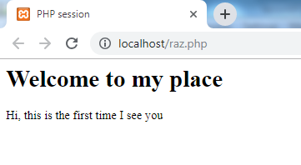
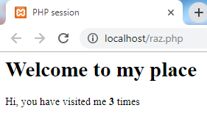
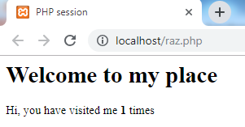
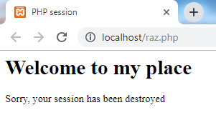
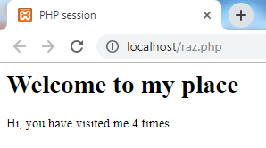
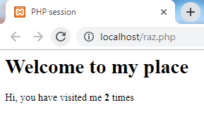
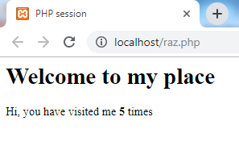
Example: PHP Session

